Slide 1
CHAPTER-8
QUADRILATERALS
MODULE-1
REMA NAIR TGT(SS) AECS-1

Slide 2
TOPICS
QUADRILATERAL
ANGLE SUM PROPERTY OF A QUADRILATERAL
TYPES OF QUADRILATERALS
POINTS TO REMEMBER
PROPERTIES OF A PARALLELOGRAM
THEOREMS

Slide 3
QUADRILATERAL
A polygon formed by joining four points in an order is called a quadrilateral.
A quadrilateral has four sides, four angles and four vertices .
In quadrilateral ABCD, AB, BC, CD and DA are the four sides.
A, B, C and D are the four vertices.
∠ A, ∠ B, ∠ C and ∠ D are the four angles formed at the vertices.
AC and BD are the two diagonals of the quadrilateral ABCD.
A
B
C
D

Slide 4
ANGLE SUM PROPERTY OF A QUADRILATERAL
STATEMENT: The sum of the angles of a quadrilateral is 360º
GIVEN: A quadrilateral ABCD
TO PROVE: ∠ A + ∠ B + ∠ C + ∠ D = 360°
CONSTRUCTION : Join AC
PROOF : By angle sum property of ∆ we get
In ∆ ADC,
∠ DAC + ∠ ACD + ∠ D = 180°------------ (1)
In ∆ ABC,
∠ CAB + ∠ ACB + ∠ B = 180°------------ (2)
Adding (1) and (2), we get
∠ DAC + ∠ ACD + ∠ D + ∠ CAB + ∠ ACB + ∠ B =180° + 180° = 360°
Also, ∠ DAC + ∠ CAB = ∠ A and ∠ ACD + ∠ ACB = ∠ C
So, ∠ A + ∠ D + ∠ B + ∠ C = 360°.
C
D
A
B

Slide 5
TYPES OF QUADRILATERALS
TRAPEZIUM
PARALLELOGRAM
RECTANGLE
RHOMBUS
One pair of opposite sides of quadrilateral are parallel.
Both pairs of opposite sides of quadrilaterals are parallel.
A parallelogram with one of its angles a right angle.
The parallelogram with all sides equal .
A quadrilateral with two pairs of adjacent sides equal .
The parallelogram with one angle 90° and all sides equal .
KITE
SQUARE

Slide 6
POINTS TO REMEMBER
A square, rectangle and rhombus are all parallelograms.
A square is a rectangle and also a rhombus.
A parallelogram is a trapezium.
A kite is not a parallelogram.
A trapezium is not a parallelogram (as only one pair of opposite sides is parallel in a trapezium and we require both pairs to be parallel in a parallelogram).
A rectangle or a rhombus is not a square.

Slide 7
PROPERTIES OF A PARALLELOGRAM
01
02
03
A diagonal of a parallelogram divides it into two congruent triangles.
Opposite sides are equal
Opposite angles are equal.
Diagonals bisect each other
04

Slide 8
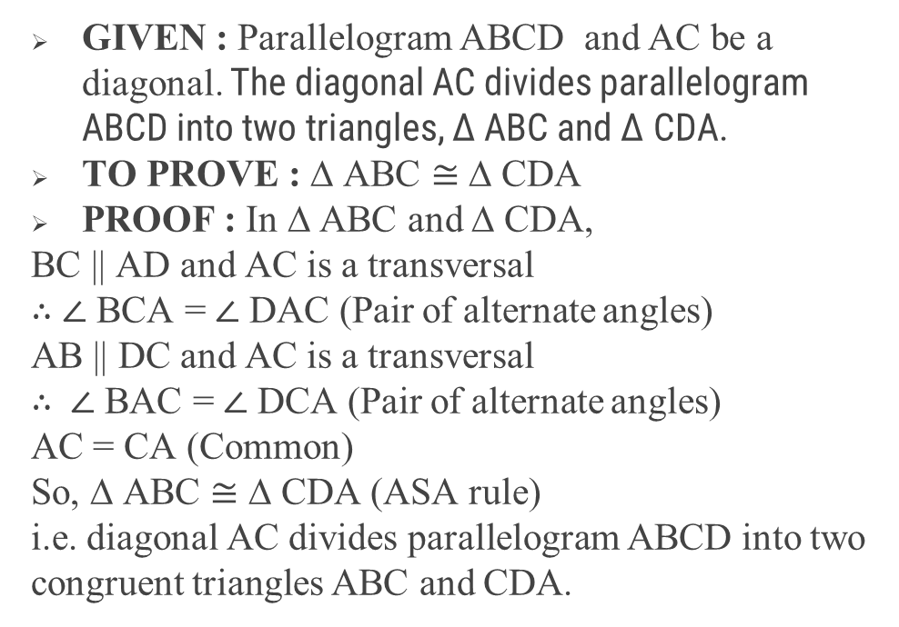
Theorem 8.1 : A diagonal of a parallelogram divides it into two congruent triangles.
GIVEN : Parallelogram ABCD and AC be a diagonal. The diagonal AC divides parallelogram ABCD into two triangles, ∆ ABC and ∆ CDA.
TO PROVE : ∆ ABC $≅$ ∆ CDA
PROOF : In ∆ ABC and ∆ CDA,
BC || AD and AC is a transversal
$∴$ ∠ BCA = ∠ DAC (Pair of alternate angles)
AB || DC and AC is a transversal
$∴$ ∠ BAC = ∠ DCA (Pair of alternate angles)
AC = CA (Common)
So, ∆ ABC ≅ ∆ CDA (ASA rule)
i.e. diagonal AC divides parallelogram ABCD into two congruent triangles ABC and CDA.
D
C
A
B

Slide 9
Theorem 8.2 : In a parallelogram, opposite sides are equal
∠ B = ∠ D (cpct)
Similarly by joining BD, we can prove
∆ ABD ≅ ∆ CDB (ASA rule)
∠ A = ∠ C (cpct)
Theorem 8.4 : In a parallelogram, opposite angles are equal.
Since , ∆ ABC ≅ ∆ CDA (ASA rule)
AB = CD
BC = DA CPCT
D
C
A
B

Slide 10
Theorem 8.6 : The diagonals of a parallelogram bisect each other.
GIVEN : ‖gm ABCD with diagonals AC and BD intersecting each other at O
TO PROVE : Diagonals bisect each other i.e. AO = CO and BO = DO
PROOF : In ∆ AOB and ∆ COD,
∠ AOB = ∠ COD [vertically opposite angles are equal]
∠OAB = ∠OCD [alternate angles are equal in ‖gm ABCD]
AB = CD [opposite sides of ‖gm ABCD]
∆ AOB $≅$ ∆ COD(SAA rule)
$∴$ AO = CO (cpct)
BO = DO (cpct)
$∴$ Diagonals bisect each other
D
C
O
A
B

Slide 11
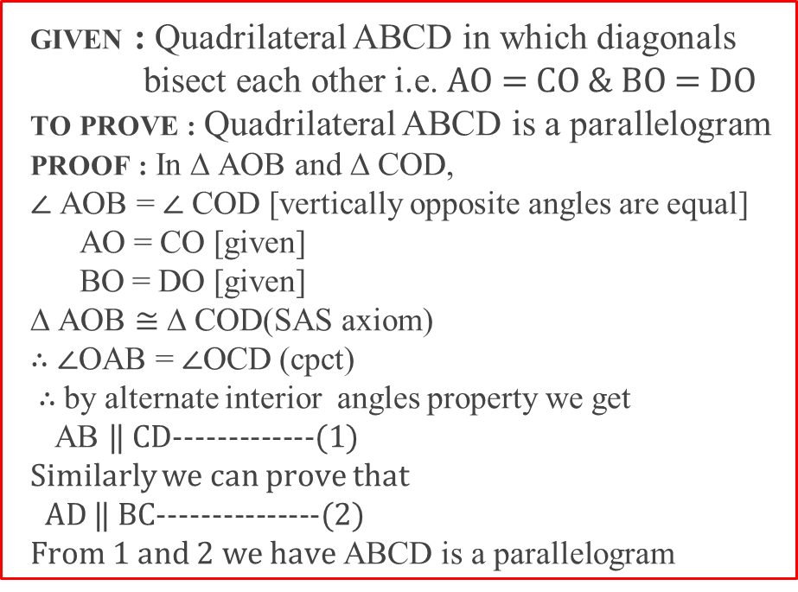
Theorem 8.7 : If the diagonals of a quadrilateral bisect each other, then it is a parallelogram.
GIVEN : Quadrilateral ABCD in which diagonals bisect each other i.e. AO = CO & BO = DO
TO PROVE : Quadrilateral ABCD is a parallelogram
PROOF : In ∆ AOB and ∆ COD,
∠ AOB = ∠ COD [vertically opposite angles are equal]
AO = CO [given]
BO = DO [given]
∆ AOB $≅$ ∆ COD(SAS axiom)
$∴$ ∠OAB = ∠OCD (cpct)
$∴$by alternate interior angles property we get
AB ‖ CD-------------(1)
Similarly we can prove that
AD ‖ BC---------------(2)
From 1 and 2 we have ABCD is a parallelogram
D
C
O
A
B

Slide 12
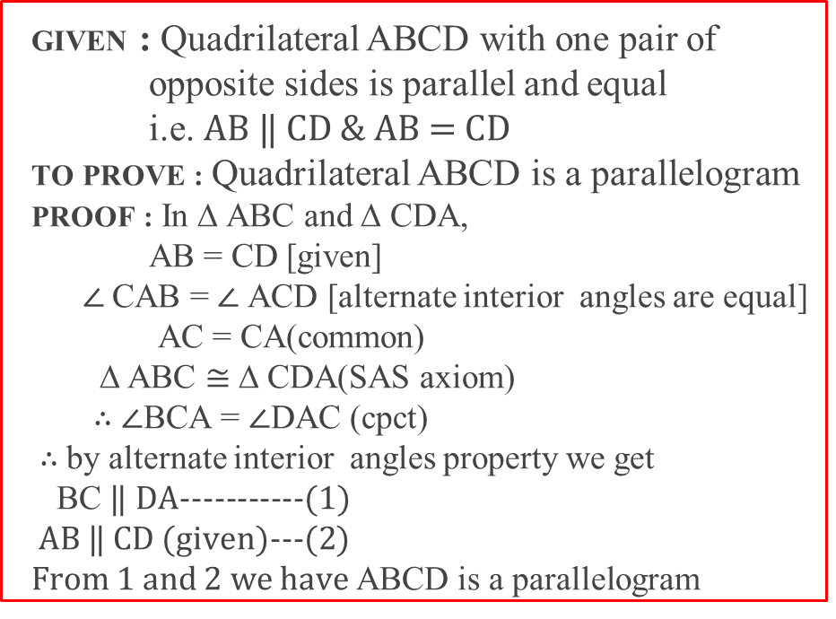
Theorem 8.8 : A quadrilateral is a parallelogram if a pair of opposite sides is equal and parallel
GIVEN : Quadrilateral ABCD with one pair of opposite sides is parallel and equal
i.e. AB ‖ CD & AB = CD
TO PROVE : Quadrilateral ABCD is a parallelogram
PROOF : In ∆ ABC and ∆ CDA,
AB = CD [given]
∠ CAB = ∠ ACD [alternate interior angles are equal]
AC = CA(common)
∆ ABC $≅$ ∆ CDA(SAS axiom)
$∴$ ∠BCA = ∠DAC (cpct)
$∴$by alternate interior angles property we get
BC ‖ DA-----------(1)
AB ‖ CD (given)---(2)
From 1 and 2 we have ABCD is a parallelogram
D
C
A
B

Slide 13
THANK YOU

